Slide 1




Notes:
*

Slide 2


UI ENGINEERING STUDIO
UI Engineering Studio. Day 13 Bootcamp: Jest

Slide 3
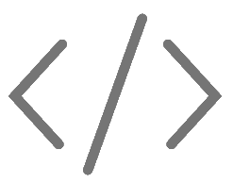

UI ENGINEERING STUDIO
What is a Unit Test?
Unit testing is a level of software testing where individual units/ components of a software are tested. The purpose is to validate that each unit of the software performs as designed. A unit is the smallest testable part of any software.
source
Unit Test
Jest
Mock
Snapshot

Slide 4

UI ENGINEERING STUDIO
UI Boot Camp: Jest What is Jest?
Jest is a tool created and maintained by the open source community with the support of Facebook. Jest emerged with the aim of adding unit tests to projects with react but it has been so important that it is increasingly used in more projects with other frameworks.
source

Slide 5
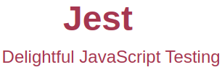
UI ENGINEERING STUDIO
UI Boot Camp: Jest Advantages of using Jest
Developer ready
Instant feedback
Snapshot testing
Zero configuration testing platform
Powerful mocking library

Slide 6
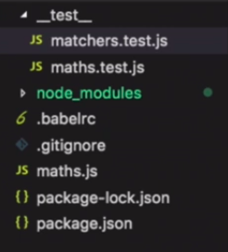
UI ENGINEERING STUDIO
UI Boot Camp: Jest Example
By default, Jest searches for the tests within the "__test__" folder, but this can be configured in the package where to look for them.

Slide 7
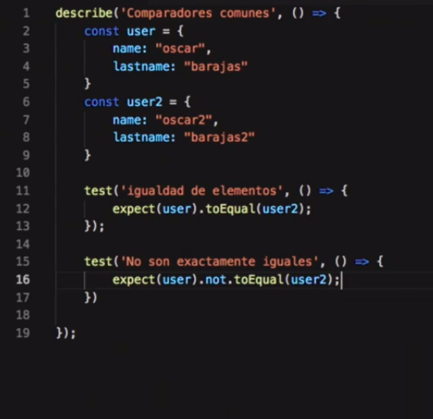
UI ENGINEERING STUDIO
UI Boot Camp: Jest Example
describe breaks your test suite into components. Depending on your test strategy, you might have a describe for each function in your class, each module of your plugin, or each user-facing piece of functionality.
Test or it is where you perform individual tests. You should be able to describe each test like a little sentence, such as "it calculates the area when the radius is set". You shouldn't be able to subdivide tests further-- if you feel like you need to, use describe instead.

Slide 8
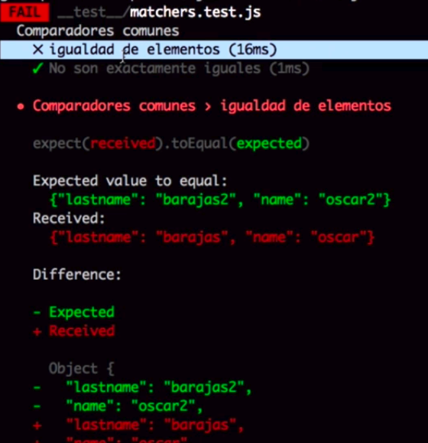
UI ENGINEERING STUDIO
UI Boot Camp: Jest Example
Output of information in console of the previous test. You can visualize correct tests and which failed.
Read more about different expect in jest

Slide 9
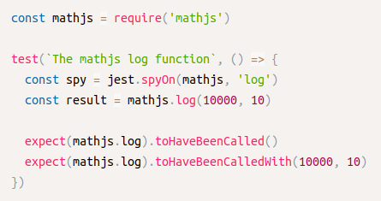
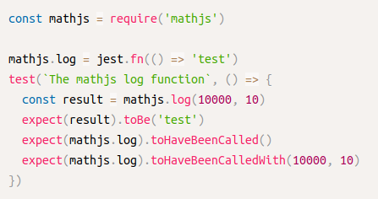
UI ENGINEERING STUDIO
With spyOn()
UI Boot Camp: Jest What is a mock?
Mock is a method/object that simulates the behavior of a real method/object in controlled ways. Mock objects are used in unit testing. Often a method under a test calls other external services or methods within it. These are called dependencies. Once mocked, the dependencies behave the way we defined them.
source
With fn()

Slide 10
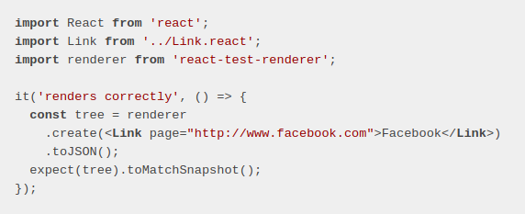
UI ENGINEERING STUDIO
UI Boot Camp: Jest Snapshot
Snapshot tests are a very useful tool whenever you want to make sure your UI does not change unexpectedly.
We can update the snapshot: jest --updateSnapshot
source

Slide 11

UI ENGINEERING STUDIO
UI Boot Camp: Jest Homework!
We’re going to continue with the TODO list.
Let’s implement Jest in ALL your components :D

Slide 12
Notes:
*

